Slide 1



ROBOT FRAMEWORK
Test Automation the Smart Way!

Slide 2

ROBOT FRAMEWORK
Test Automation the Smart Way!

Slide 3


Introduction
Robot Framework is a Python-based, extensible keyword-driven test automation framework for end-to-end acceptance testing and acceptance-test-driven development (ATDD).
It can be used for testing distributed, heterogeneous applications, where verification requires touching several technologies and interfaces.
Robot Framework is operating system and application independent.
It empowers testers to automate and manage complex workflow scripts efficiently.
Robot Framework is open source software released under Apache License 2.0,
Implemented with Python
– Runs also on Jython (JVM) and IronPython (.NET)
– Can be extended natively using Python or Java
– Other languages supported via a remote interface

Slide 4

Why Robot?
Robot is keyword driven
Robot is highly extensible
Robot integrates with development tools
Robot has robust reporting
Logging and Failure Analysis
Multiple Operating Systems support
Reusable/custom keywords
Maintainability is easy
Extensive set of standard, external libraries
Ease of use
& Flexibility

Slide 5
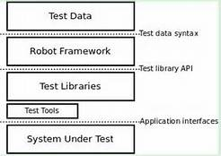
High Level Architecture
Robot Framework has a modular architecture that can be extended with bundled and self-made test libraries.
When test execution is started, the framework first parses the test data. It then utilizes keywords provided by the test libraries to interact with the system under test. Libraries can communicate with the system either directly or using other test tools as drivers.
Test execution is started from the command line. As a result you get report and log in HTML format as well as an XML output. These provide extensive look into what your system does.

Slide 6

Test Libraries
Standard Libraries
Built-in
Operating System
Process
Telnet
Remote
Screenshot
External Libraries
Test libraries provide the actual testing capabilities to Robot Framework by providing keywords. There are several standard libraries that are bundled in with the framework, and galore of separately developed external libraries that can be installed based on your needs
Selenium2Library
HTTP
FTP
Rammbock
SSH
Django
Android
IOS

Slide 7

Important libraries for automating router implementation
Telnet
Makes it possible to connect to Telnet servers and execute commands on the opened connections.
Operating System
The operating systems library provides the flexibility execute any OS command in the environment or the machine the script is being executed
Rammbock
Rammbock is unique library which help developing automation test cases to a Networking domain based application. Rammbock is a simple python based library that will help to automate the generation of simple TCP/IP or UDP based packets.
SSH
With the SSH library an automation script can connect to a remote UNIX or a LINUX machine and execute any commands remotely.

Slide 8
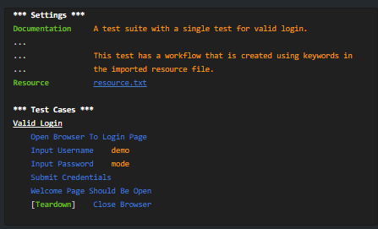
Example:System Test Automation
Simple keyword driven syntax

Slide 9
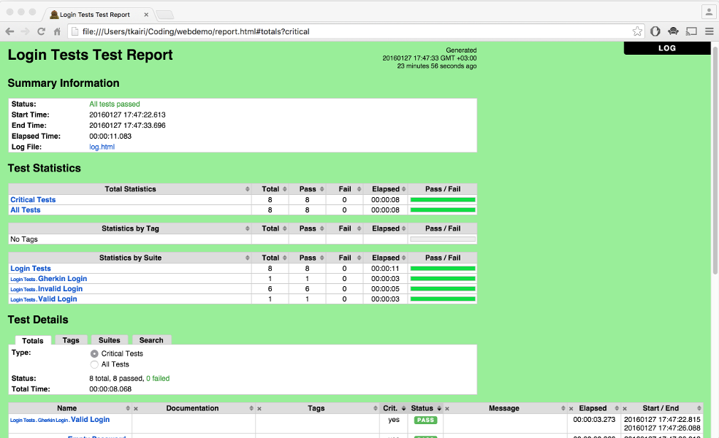
Test results-Test Report
Report details clearly viewable statistics including Pass/Fail ratios and elapsed times. This gives you great overview on the test execution.

Slide 10
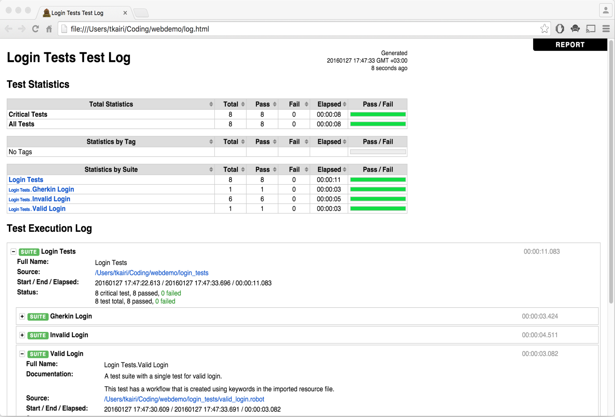
TestLog
Log details statistics from each step of the test execution, from keyword to keyword. It enables you to drill down on the specifics of the test in case of failure or otherwise.

Slide 11

Thank You

